Slide 1
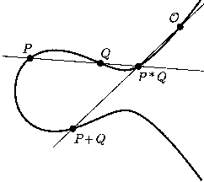
Elliptic Curve Cryptography
Speaker : Debdeep Mukhopadhyay
Dept of Computer Sc and Engg
IIT Madras

Slide 2
Outline of the Talk…
Introduction to Elliptic Curves
Elliptic Curve Cryptosystems (ECC)
Implementation of ECC in Binary Fields

Slide 3
Introduction to Elliptic Curves

Slide 4
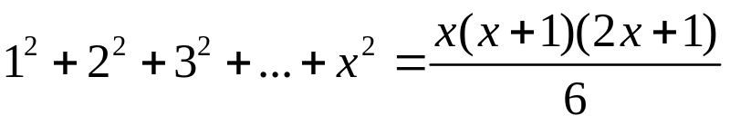
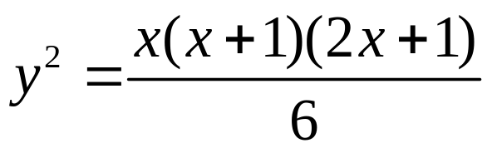
Lets start with a puzzle…
What is the number of balls that may be piled as a square pyramid and also rearranged into a square array?
Soln: Let x be the height of the pyramid…
Thus,
We also want this to be a square:
Hence,

Slide 5
Graphical Representation
Y axis
X axis
Curves of this nature
are called ELLIPTIC
CURVES

Slide 6
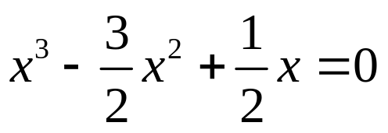
Method of Diophantus
Uses a set of known points to produce new points
(0,0) and (1,1) are two trivial solutions
Equation of line through these points is y=x.
Intersecting with the curve and rearranging terms:
We know that 1 + 0 + x = 3/2 =>
x = ½ and y = ½
Using symmetry of the curve we also have (1/2,-1/2) as another solution

Slide 7
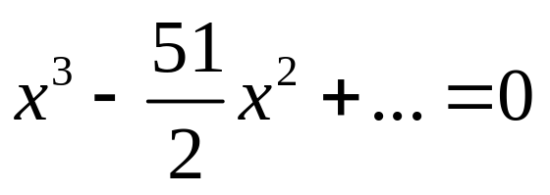
Diophantus’ Method
Consider the line through (1/2,-1/2) and (1,1) => y=3x-2
Intersecting with the curve we have:
Thus ½ + 1 + x = 51/2 or x = 24 and y=70
Thus if we have 4900 balls we may arrange them in either way

Slide 8
Elliptic curves in Cryptography
Elliptic Curve (EC) systems as applied to cryptography were first proposed in 1985 independently by Neal Koblitz and Victor Miller.
The discrete logarithm problem on elliptic curve groups is believed to be more difficult than the corresponding problem in (the multiplicative group of nonzero elements of) the underlying finite field.

Slide 9

Discrete Logarithms in Finite Fields
F={1,2,3,…,p-1}
Pick secret, random Y from F
Pick secret, random X from F
g^{x} mod p
g^{y} mod p
Alice
Bob
Compute k=(g^{y})^{x}=g^{xy} mod p
Compute k=(g^{x})^{y}=g^{xy} mod p
Eve has to compute g^{xy} from g^{x} and g^{y} without knowing x and y…
She faces the Discrete Logarithm Problem in finite fields

Slide 10
Elliptic Curve on a finite set of Integers
Consider y² = x³ + 2x + 3 (mod 5)
x = 0 ⇒ y² = 3 ⇒ no solution (mod 5)
x = 1 ⇒ y² = 6 = 1 ⇒ y = 1,4 (mod 5)
x = 2 ⇒ y² = 15 = 0 ⇒ y = 0 (mod 5)
x = 3 ⇒ y² = 36 = 1 ⇒ y = 1,4 (mod 5)
x = 4 ⇒ y² = 75 = 0 ⇒ y = 0 (mod 5)
Then points on the elliptic curve are
(1,1) (1,4) (2,0) (3,1) (3,4) (4,0) and the point at infinity: ∞
Using the finite fields we can form an Elliptic Curve Group
where we also have a DLP problem which is harder to solve…

Slide 11
Definition of Elliptic curves
An elliptic curve over a field K is a nonsingular cubic curve in two variables, f(x,y) =0 with a rational point (which may be a point at infinity).
The field K is usually taken to be the complex numbers, reals, rationals, algebraic extensions of rationals, p-adic numbers, or a finite field.
Elliptic curves groups for cryptography are examined with the underlying fields of F_{p} (where p>3 is a prime) and F₂^{m} (a binary representation with 2^{m} elements).

Slide 12
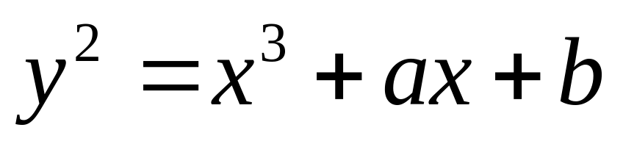
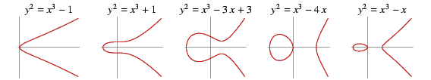
General form of a EC
An elliptic curve is a plane curve defined by an equation of the form
Examples

Slide 13
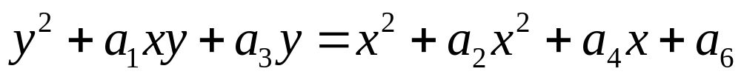
Weierstrass Equation
A two variable equation F(x,y)=0, forms a curve in the plane. We are seeking geometric arithmetic methods to find solutions
Generalized Weierstrass Equation of elliptic curves:
Here, A, B, x and y all belong to a field of say rational
numbers, complex numbers, finite fields (F_{p}) or
Galois Fields (GF(2^{n})).

Slide 14
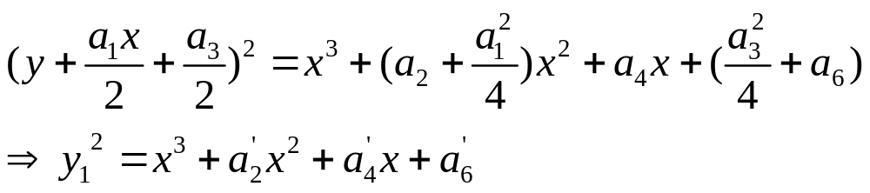
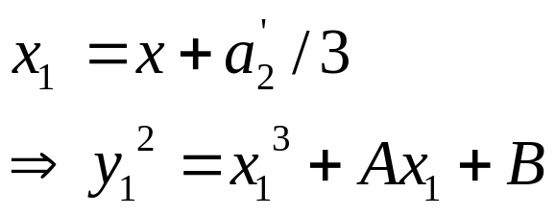
If Characteristic field is not 2:
If Characteristics of field is neither 2 nor 3:

Slide 15
Points on the Elliptic Curve (EC)
Elliptic Curve over field L
It is useful to add the point at infinity
The point is sitting at the top of the y-axis and any line is said to pass through the point when it is vertical
It is both the top and at the bottom of the y-axis

Slide 16
The Abelian Group
Given two points P,Q in E(Fp), there is a third point, denoted by P+Q on E(Fp), and the following relations hold for all P,Q,R in E(Fp)
P + Q = Q + P (commutativity)
(P + Q) + R = P + (Q + R) (associativity)
P + O = O + P = P (existence of an identity element)
there exists ( − P) such that − P + P = P + ( − P) = O (existence of inverses)

Slide 17
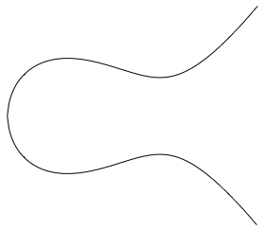
Elliptic Curve Picture
y
Consider elliptic curve
  E: y² = x³ - x + 1
If P₁ and P₂ are on E, we can define
P₃ = P₁ + P₂
as shown in picture
Addition is all we need
P₂
P₁
x
P₃

Slide 18
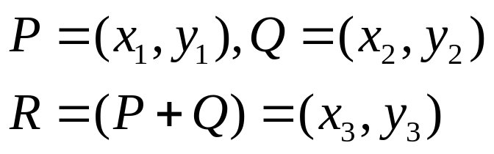
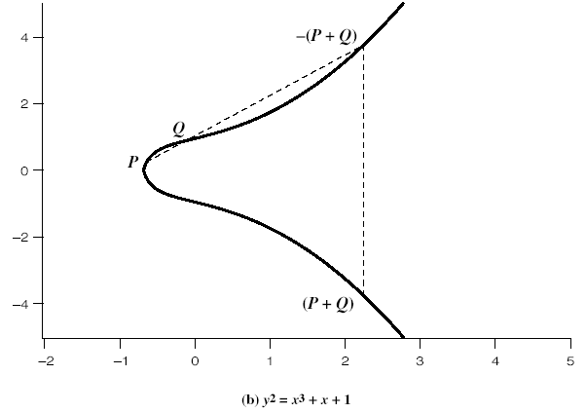
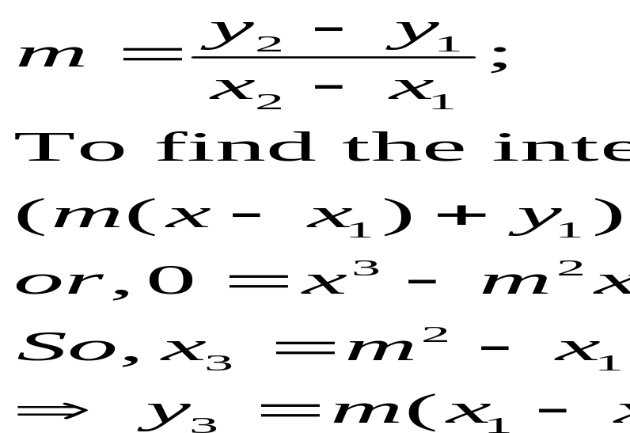
Addition in Affine Co-ordinates
y=m(x-x₁)+y₁
y
Let, P≠Q,
x
y²=x³+Ax+B

Slide 19
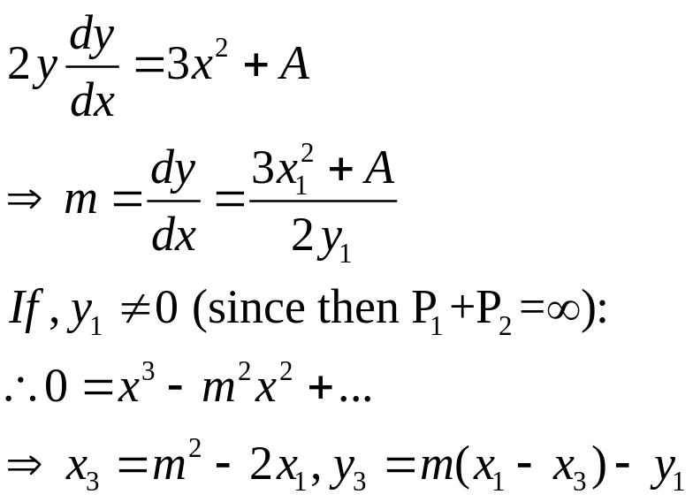
Doubling of a point
Let, P=Q
What happens when P₂=∞?

Slide 20
Why do we need the reflection?
y
P₂=O=∞
P₁=P₁+ O=P₁
P₁

Slide 21
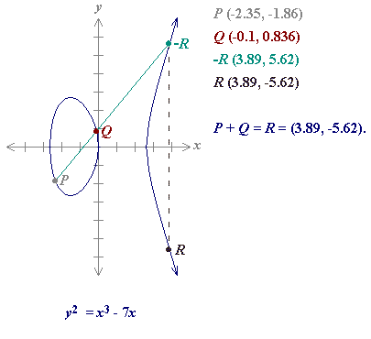
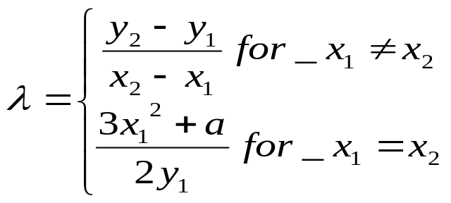
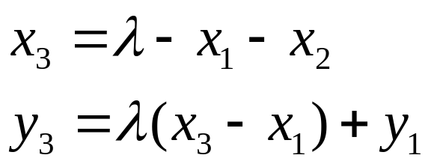
Sum of two points
Define for two points P (x₁,y₁) and Q (x₂,y₂) in the Elliptic curve
Then P+Q is given by R(x₃,y₃) :

Slide 22
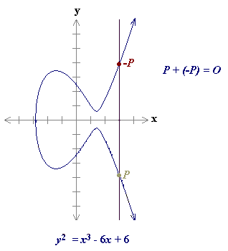
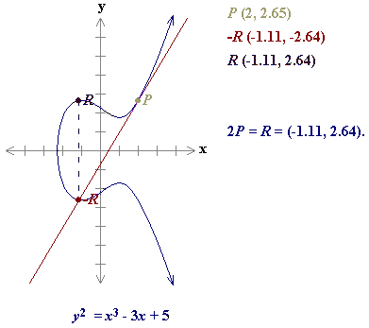
Point at infinity O
P+P = 2P
As a result of the above case P=O+P
O is called the additive identity of the elliptic curve group.
Hence all elliptic curves have an additive identity O.

Slide 23

Projective Co-ordinates
Two-dimensional projective space over K is given by the equivalence classes of triples (x,y,z) with x,y z in K and at least one of x, y, z nonzero.
Two triples (x₁,y₁,z₁) and (x₂,y₂,z₂) are said to be equivalent if there exists a non-zero element λ in K, st:
  (x₁,y₁,z₁) = (λx₂, λy₂, λz₂)
  The equivalence class depends only the ratios and hence is denoted by (x:y:z)

Slide 24
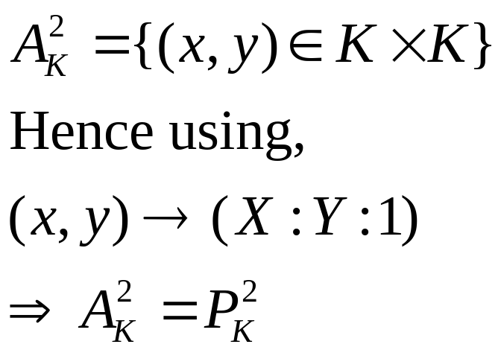
Projective Co-ordinates
If z≠0, (x:y:z)=(x/z:y/z:1)
What is z=0? We obtain the point at infinity.
The two dimensional affine plane over K:
There are advantages with projective co-ordinates
from the implementation point of view

Slide 25
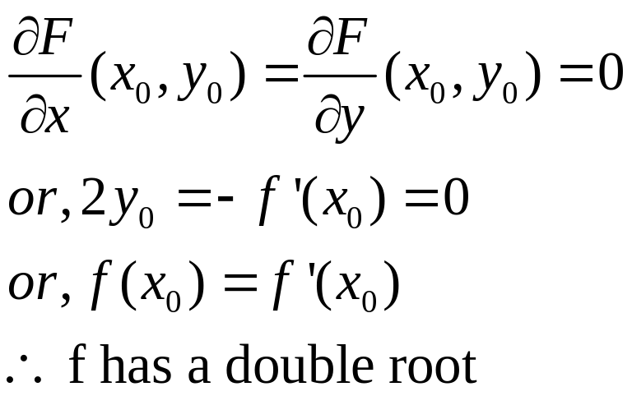
Singularity
For an elliptic curve y²=f(x), define
F(x,y)=y²-F(x). A singularity of the EC is a pt (x₀,y₀) such that:
It is usual to assume the EC has no singular points

Slide 26
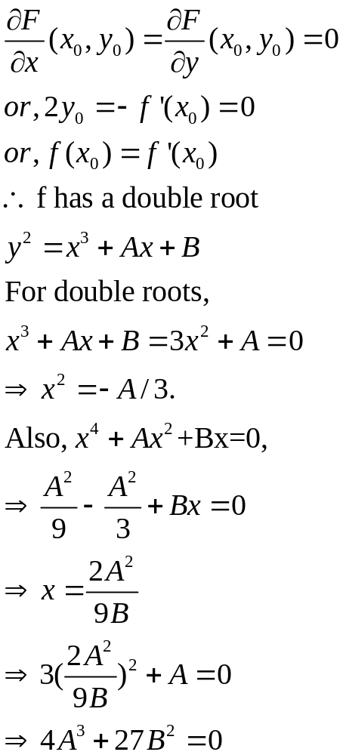
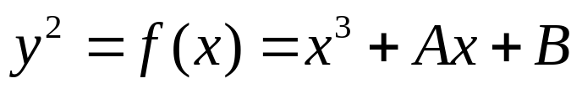
If Characteristics of field is not 3:
Hence condition for no singularity is 4A³+27B²≠0
Generally, EC curves have no singularity

Slide 27
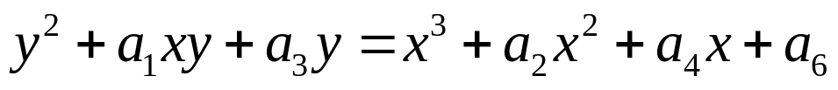



Elliptic Curves in Characteristic 2
Generalized Equation:
If a₁ is not 0, this reduces to the form:
If a₁ is 0, the reduced form is:
Note that the form cannot be:

Slide 28
Outline of the Talk…
Introduction to Elliptic Curves
Elliptic Curve Cryptosystems
Implementation of ECC in Binary Fields

Slide 29
Elliptic Curve Cryptosystems
(ECC)

Slide 30

Public-Key Cryptosystems
Authentication: Only A can
generate the encrypted message
Secrecy: Only B can Decrypt
the message
Notes:
Stallings Fig 9-4.
Here see various components of public-key schemes used for both secrecy and authentication. Note that separate key pairs are used for each of these – receiver owns and creates secrecy keys, sender owns and creates authentication keys.

Slide 31
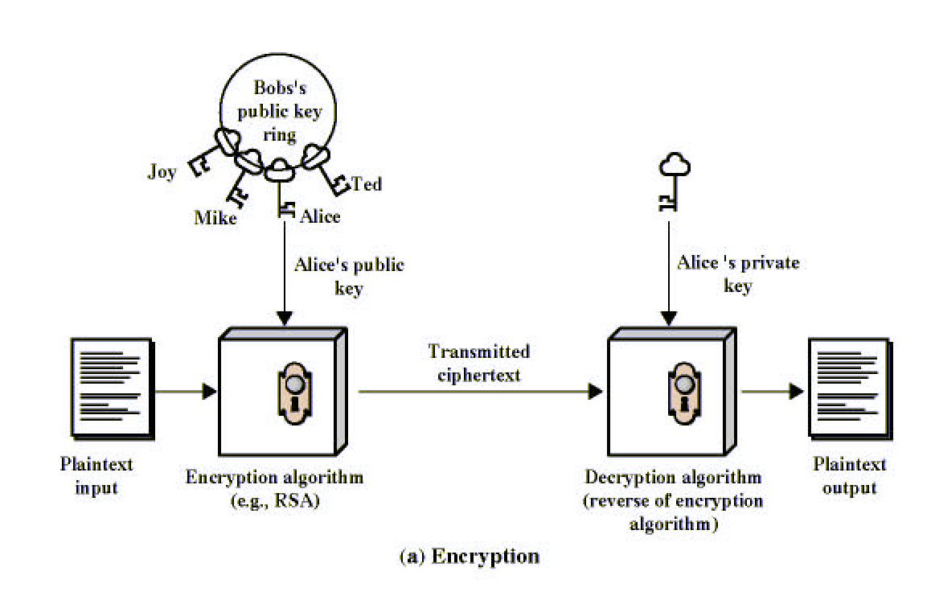
Public-Key Cryptography
Notes:
Stallings Fig 9-1.

Slide 32
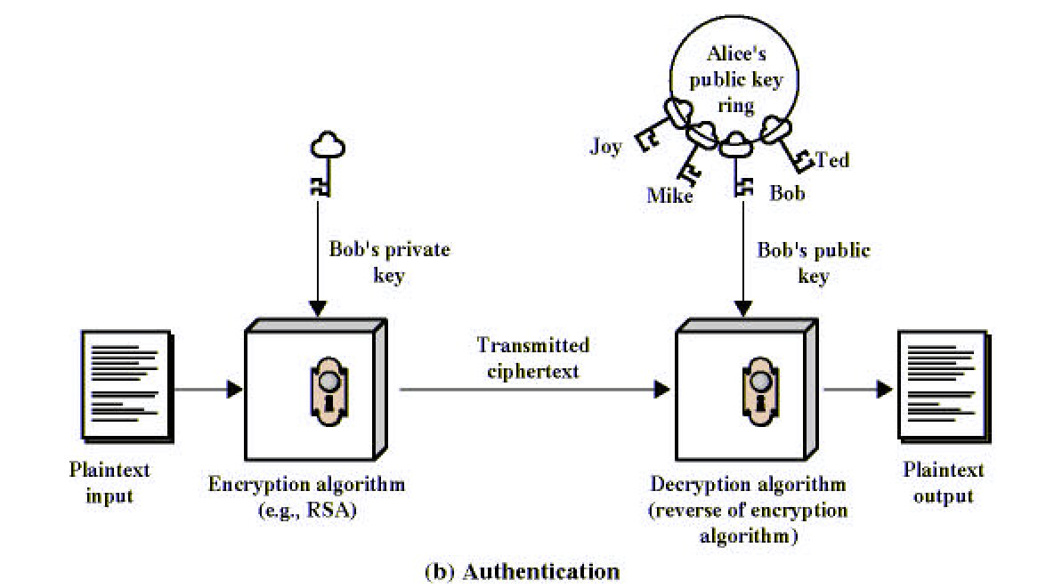
Public-Key Cryptography
Notes:
Stallings Fig 9-1.

Slide 33
What Is Elliptic Curve Cryptography (ECC)?
Elliptic curve cryptography [ECC] is a public-key cryptosystem just like RSA, Rabin, and El Gamal.
Every user has a public and a private key.
  Public key is used for encryption/signature verification.
  Private key is used for decryption/signature generation.
Elliptic curves are used as an extension to other current cryptosystems.
  Elliptic Curve Diffie-Hellman Key Exchange
  Elliptic Curve Digital Signature Algorithm

Slide 34
Using Elliptic Curves In Cryptography
The central part of any cryptosystem involving elliptic curves is the elliptic group.
All public-key cryptosystems have some underlying mathematical operation.
  RSA has exponentiation (raising the message or ciphertext to the public or private values)
  ECC has point multiplication (repeated addition of two points).

Slide 35
Generic Procedures of ECC
Both parties agree to some publicly-known data items
  The elliptic curve equation
    values of a and b
    prime, p
  The elliptic group computed from the elliptic curve equation
  A base point, B, taken from the elliptic group
    Similar to the generator used in current cryptosystems
Each user generates their public/private key pair
  Private Key = an integer, x, selected from the interval [1, p-1]
  Public Key = product, Q, of private key and base point
    (Q = x*B)

Slide 36
Example – Elliptic Curve Cryptosystem Analog to El Gamal
Suppose Alice wants to send to Bob an encrypted message.
  Both agree on a base point, B.
  Alice and Bob create public/private keys.
    Alice
      Private Key = a
      Public Key = P_{A} = a * B
    Bob
      Private Key = b
      Public Key = P_{B} = b * B
  Alice takes plaintext message, M, and encodes it onto a point, P_{M}, from the elliptic group

Slide 37
Example – Elliptic Curve Cryptosystem Analog to El Gamal
  Alice chooses another random integer, k from the interval [1, p-1]
  The ciphertext is a pair of points
    P_{C} = [ (kB), (P_{M} + kP_{B}) ]
  To decrypt, Bob computes the product of the first point from P_{C} and his private key, b
    b * (kB)
  Bob then takes this product and subtracts it from the second point from P_{C}
    (P_{M} + kP_{B}) – [b(kB)] = P_{M} + k(bB) – b(kB) = P_{M}
  Bob then decodes P_{M} to get the message, M.

Slide 38
Example – Compare to El Gamal
  The ciphertext is a pair of points
    P_{C} = [ (kB), (P_{M} + kP_{B}) ]
  The ciphertext in El Gamal is also a pair.
    C = (g^{k} mod p, mP_{B}^{k} mod p)
  --------------------------------------------------------------------------
  Bob then takes this product and subtracts it from the second point from P_{C}
    (P_{M} + kP_{B}) – [b(kB)] = P_{M} + k(bB) – b(kB) = P_{M}
  In El Gamal, Bob takes the quotient of the second value and the first value raised to Bob’s private value
    m = mP_{B}^{k} / (g^{k})^{b} = mg^{k*b} / g^{k*b} = m

Slide 39
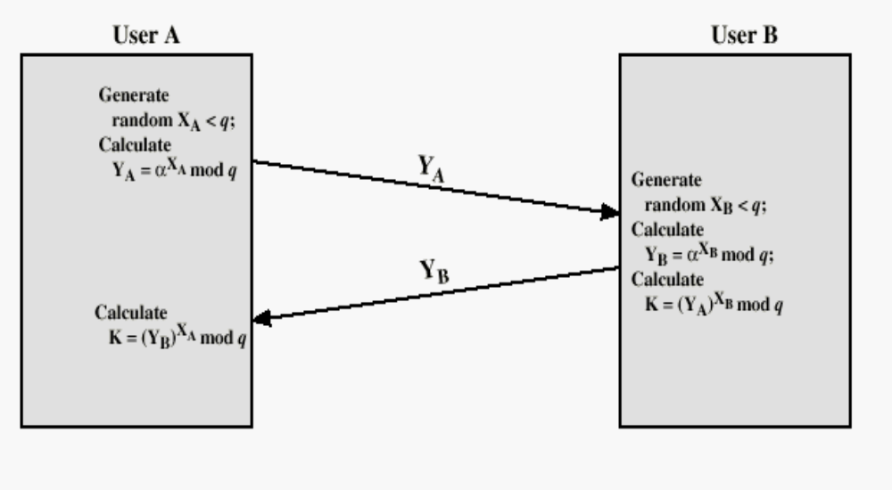
Diffie-Hellman (DH) Key Exchange

Slide 40
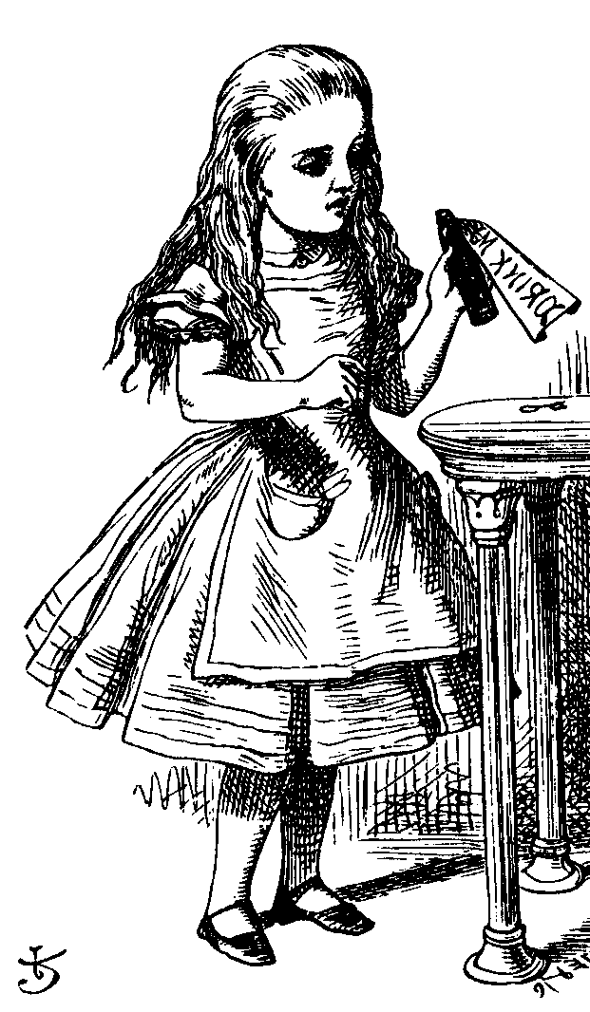
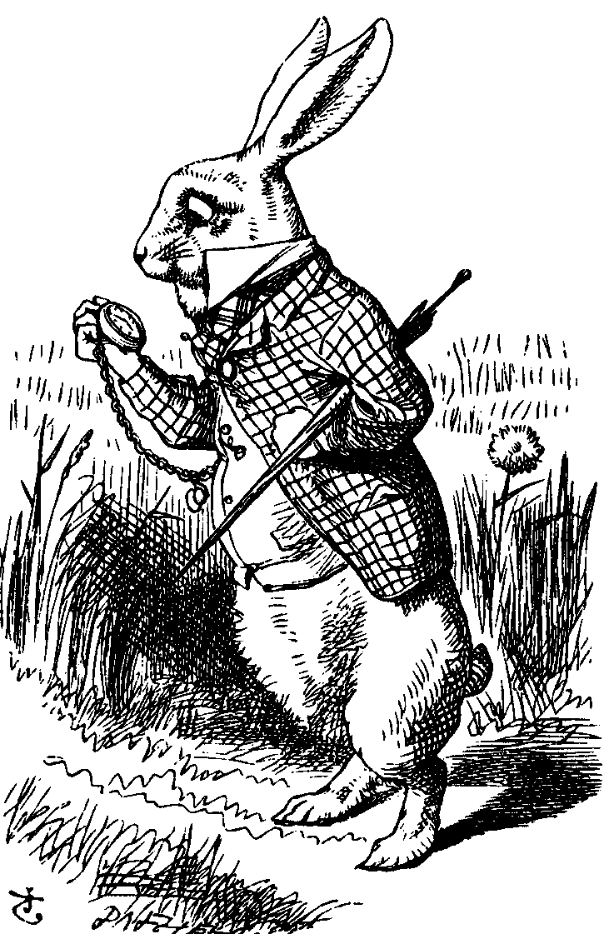
ECC Diffie-Hellman
Public: Elliptic curve and point B=(x,y) on curve
Secret: Alice’s a and Bob’s b
a(x,y)
b(x,y)
Alice, A
Bob, B
Alice computes a(b(x,y))
Bob computes b(a(x,y))
These are the same since ab = ba

Slide 41
Example – Elliptic Curve
Diffie-Hellman Exchange
Alice and Bob want to agree on a shared key.
  Alice and Bob compute their public and private keys.
    Alice
        Private Key = a
        Public Key = P_{A} = a * B
    Bob
        Private Key = b
        Public Key = P_{B} = b * B
  Alice and Bob send each other their public keys.
  Both take the product of their private key and the other user’s public key.
    Alice → K_{AB} = a(bB)
    Bob → K_{AB} = b(aB)
    Shared Secret Key = K_{AB} = abB

Slide 42
Why use ECC?
How do we analyze Cryptosystems?
  How difficult is the underlying problem that it is based upon
    RSA – Integer Factorization
    DH – Discrete Logarithms
    ECC - Elliptic Curve Discrete Logarithm problem
  How do we measure difficulty?
    We examine the algorithms used to solve these problems

Slide 43
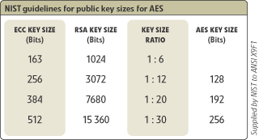
Security of ECC
To protect a 128 bit AES key it would take a:
  RSA Key Size: 3072 bits
  ECC Key Size: 256 bits
How do we strengthen RSA?
  Increase the key length
Impractical?

Slide 44
Applications of ECC
Many devices are small and have limited storage and computational power
Where can we apply ECC?
  Wireless communication devices
  Smart cards
  Web servers that need to handle many encryption sessions
  Any application where security is needed but lacks the power, storage and computational power that is necessary for our current cryptosystems

Slide 45
Benefits of ECC
Same benefits of the other cryptosystems: confidentiality, integrity, authentication and non-repudiation but…
Shorter key lengths
  Encryption, Decryption and Signature Verification speed up
  Storage and bandwidth savings

Slide 46
Summary of ECC
“Hard problem” analogous to discrete log
  Q=kP, where Q,P belong to a prime curve
  given k,P → “easy” to compute Q
  given Q,P → “hard” to find k
  known as the elliptic curve logarithm problem
    k must be large enough
ECC security relies on elliptic curve logarithm problem
  compared to factoring, can use much smaller key sizes than with RSA etc
      for similar security ECC offers significant
  computational advantages

Slide 47
Outline of the Talk…
Introduction to Elliptic Curves
Elliptic Curve Cryptosystems
Implementation of ECC in Binary Fields

Slide 48
Implementation of ECC in Binary Fields

Slide 49
Sub-Topics
Scalar Multiplication: LSB first vs MSB first
Montgomery Technique of Scalar Multiplication
Fast Scalar Multiplication without pre-computation.
Lopez and Dahab Projective Transformation to Reduce Inverters
Mixed Coordinates
Parallelization Techniques
Half and Add Technique for Scalar Multiplication

Slide 50
ECC operations: Hierarchy
ECC
Level 0
Point
multiplication:
kP
Level 1
Group operation:
point add/double
Level 2
Parallelize the architectures
Finite field arithmetic: multiplication,
addition, subtraction, inversion, …
Level 3

Slide 51
Scalar Multiplication: MSB first
Require k=(k_{m-1},k_{m-2},…,k₀)₂, k_{m}=1
Compute Q=kP
  Q=P
  For i=m-2 to 0
    Q=2Q
    If k_{i}=1 then
      Q=Q+P
    End if
  End for
  Return Q
Sequential Algorithm
Requires m point doublings and
(m-1)/2 point additions on the
average

Slide 52
Example
Compute 7P:
  7=(111)₂
  7P=2(2(P)+P)+P=> 2 iterations are required
  Principle: First double and then add (accumulate)
Compute 6P:
  6=(110)₂
  6P=2(2(P)+P)

Slide 53
Scalar Multiplication: LSB first
Require k=(k_{m-1},k_{m-2},…,k₀)₂, k_{m}=1
Compute Q=kP
  Q=0, R=P
  For i=0 to m-1
    If k_{i}=1 then
      Q=Q+R
    End if
    R=2R
  End for
  Return Q
Can Parallelize…
What you are doubling and what
you are accumulating are
different…
On the average m/2 point
Additions and m/2 point
doublings

Slide 54
Example
Compute 7P, 7=(111)₂, Q=0, R=P
  Q=Q+R=0+P=P, R=2R=2P
  Q=P+2P=3P, R=4P
  Q=7P, R=8P
Compute 6P, 6=(110)₂, Q=0, R=P
  Q=0, R=2R=2P
  Q=0+2P=2P, R=4P
  Q=2P+4P=6P, R=8P

Slide 55
Compute 31P…
31=(11111)₂
MSB First
LSB First
Q=2P
Q=3P
Q=6P
Q=7P
Q=14P
Q=15P
Q=30P
Q=31P
Q=P, R=2P
Q=3P, R=4P
Q=7P, R=8P
Q=15P, R=16P
Q=31P, R=32P

Slide 56
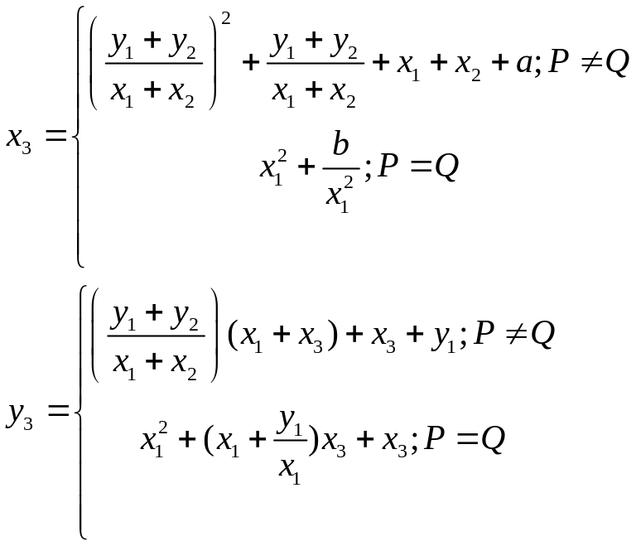
Weierstrass Point Addition
Let, P=(x₁,y₁) be a point on the curve.
-P=(x₁,x₁+y₁)
Let, R=P+Q=(x₃,y₃)
Point addition and doubling
each require 1 inversion
& 2 multiplications
2. We neglect the costs of
squaring and addition
3. Montgomery noticed that the
x-coordinate of 2P does not
depend on the y-coordinate of
P

Slide 57
Montgomery’s method to perform scalar multiplication
Input: k>0, P
Output: Q=kP
Set k<-(k_{l-1},…,k₁,k₀)₂
Set P₁=P, P₂=2P
For i from l-2 to 0
  If k_{i}=1,
    Set P₁=P₁+P₂, P₂=2P₂
    else
    Set P₂=P₂+P₁, P₁=2P₁
Return Q=P₁
Invariant Property:
P=P₂-P₁
Question: How to implement the
Operation efficiently?

Slide 58
Example
Compute 7P
7=(111)₂
Initialization:
P₁=P; P₂=2P
Steps:
  P₁=3P, P₂=4P
  P₁=7P, P₂=8P
Compute 6P
7=(110)₂
Initialization:
P₁=P; P₂=2P
Steps:
  P₁=3P, P₂=4P
  P₂=7P, P₁=6P

Slide 59
Fast Multiplication on EC without pre-computation

Slide 60
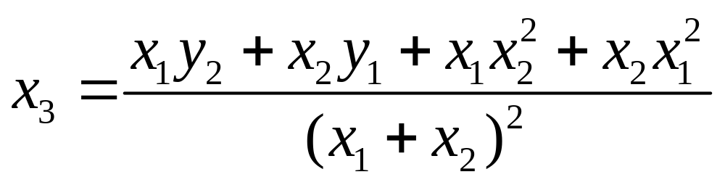
Result-1
Let P₁ = (x₁,y₁) and P₂=(x₂,y₂) be elliptic points. Then the x-coordinate of P₁+P₂, x₃ can be computed as:
Hint: Remember that the field has a characteristic 2
and that P₁ and P₂ are points on the curve

Slide 61
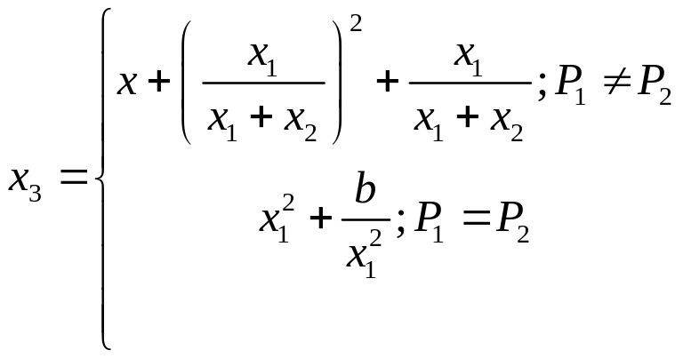
Result-2
Let P=(x,y), P₁ = (x₁,y₁) and P₂=(x₂,y₂) be elliptic points. Let P=P₂-P₁ be an invariant.
Then the x-coordinate of P₁+P₂, x₃ can be computed in terms of the x-coordinates as:

Slide 62
Result-3
Let P=(x,y), P₁=(x₁,y₁) and P₂=(x₂,y₂) be elliptic points. Assume that P₂-P₁=P and x is not 0. Then the y-coordinates of P₁ can be expressed in terms of P, and the x-coordinates of P₁ and P₂ as follows:

Slide 63
Final Algorithm
Input: k>0, P=(x,y)
Output: Q=kP
If k=0 or x=0 then output(0,0)
Set k = (k_{l-1},k_{l-2},…,k₀)₂
Set x₁=x, x₂=x²+b/x²
For i from l-2 to 0
  Set t=x₁/(x₁+x₂)
  If k_{i}=1,
  x₁=x+t²+t, x₂=x₂²+b/x₂²
  else
  x₁=x₁²+b/x₁², x₂=x+t²+t
r₁=x₁+x, r₂=x₂+x
y₁=r₁(r₁r₂+x²+y)/x+y
Return Q=(x₁,y₁)
#INV:2(l-2)+1;
#MULT: 2(l-2)+4
#ADD: 4(l-2)+6
#SQR: 2(l-2)+2

Slide 64

How to reduce inversions?
In affine coordinates Inverses are very expensive
For each inversion requires around 7 multipliers (in hardware designs)
Lopez Dahab Projective coordinates:
  (X,Y,Z), Z≠0, maps to (X/Z,Y/Z²)
  Motivation is to replace inversions by the multiplication operations and then perform one inversion at the end (to obtain back the affine coordinates)

Slide 65
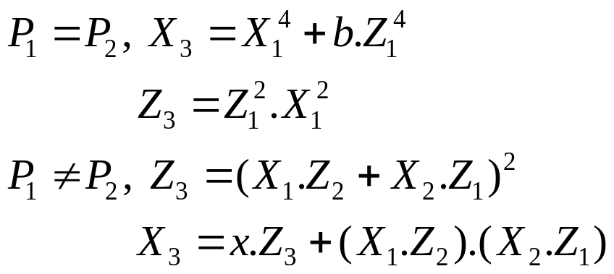
Doubling
2 inverses
1 general field
multiplication
4 additions
2 squarings
Remember:
In Projective Coordinates:
0 inverses
4 general field
multiplications
3 additions
5 squarings

Slide 66
Montgomery Algorithm
Input: k>0, P=(x,y)
Output: Q=kP
Set k<-(k_{l-1},…,k₁,k₀)₂
Set X₁=x, Z₁=1; X₂=x⁴+b, Z₂=x²
For i from l-2 to 0
  If k_{i} =1,
    Madd(X₁,Z₁,X₂,Z₂), Mdouble(X₂,Z₂)
    else
    Madd(X₂,Z₂,X₁,Z₁), Mdouble(X₁,Z₁)
Return Q=(Mxy(X₁,Y₁,X₂,Y₂))

Slide 67
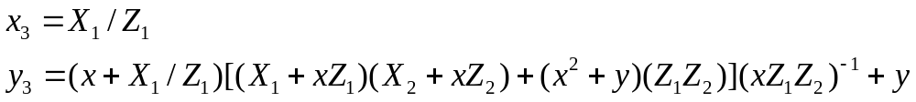
Mxy: Projective to Affine
Requires 10 multiplications and one inverse operation

Slide 68
Final Comparison
Affine Coordinates
Inv: 2logk + 1
Mult: 2logk + 4
Add: 4logk + 6
Sqr: 2logk + 2
Projective Coordinates
Inv: 1
Mult: 6logk + 10
Add: 3logk + 7
Sqr: 5logk + 3
Hence, final decision depends upon the I:M ratio of the finite field operators

Slide 69
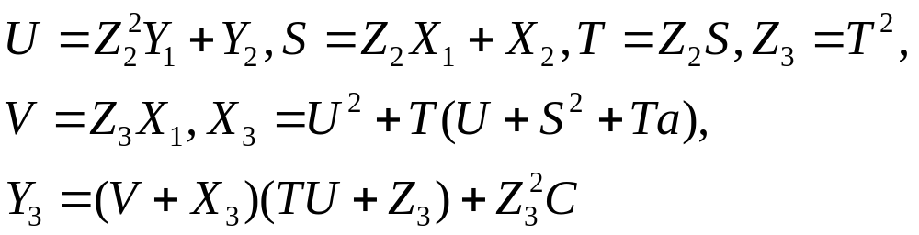
Addition in Mixed Coordinates
Theorem: Let P₁=(X₁/Z₁,Y₁/Z₁²) and P₂=(X₂/Z₂,Y₂/Z₂²) be two points on the curve. If Z₁=1, then P₁+P₂=(X₃/Z₃,Y₃/Z₃²) st.
Number of multiplications are further reduced.
Squaring is increased a bit, but they are cheap in GF(2^{n})
Improvement by 10 % if a≠0, otherwise 12 %...

Slide 70
Parallel Strategies for Scalar Point Multiplication
Point Doubling
  Cycle 1: T=X₁², M=cZ₁², Z₂=T.Z₁²
  Cycle 1a: X₂=T²+M²
Point Addition
  Cycle 1: t₁=(X₁.Z₂); t₂=(Z₁.X₂)
  Cycle 1a: M=(t₁+t₂), Z₁=M²
  Cycle 2: N=t₁.t₂, M=xZ₁
  Cycle 2a: X₁=M+N
1 multiplier
2 multipliers
We assume that squarings and multiplications with constants can be
performed without multipliers…

Slide 71
Parallelizing Montgomery Algorithm
Input: k>0, P=(x,y)
Output: Q=kP
Set k<-(k_{l-1},…,k₁,k₀)₂
Set X₁=x, Z₁=1; X₂=x⁴+b, Z₂=x²
For i from l-2 to 0
  If k_{i} =1,
  5a) Madd(X₁,Z₁,X₂,Z₂), Mdouble(X₂,Z₂)
    else
    5b) Madd(X₂,Z₂,X₁,Z₁), Mdouble(X₁,Z₁)
Return Q=(Mxy(X₁,Y₁,X₂,Y₂))

Slide 72
Looking back at our
Design Hierarchy
ECC
Level 0
Point
multiplication:
kP
Level 1
Group operation:
point add/double
Level 2
Parallelize the architectures
Finite field arithmetic: multiplication,
addition, subtraction, inversion, …
Level 3

Slide 73
Parallelizing Strategies
Parallelize level 1: If we allocate one multiplier to each of Madd and Mdouble, then we can parallelize steps 5a and 5b. Thus 4 clock cycles are required for each iteration. Total time is nearly 4l.
Parallelize level 2: If we can parallelize the underlying Madd and Mdouble, then we cannot parallelize level 1, if we have constraint of 2 multipliers. So, we have a sequential step 5a and 5b. Total time is 3l.

Slide 74
Parallelizing Strategies
Parallelize both the levels: Total time is 2l clock cycles. Require 3 multipliers.
Thus Montgomery algorithm is highly parallelizable
Helpful in high performance designs (low power, high thoughput etc)

Slide 75
Point Halving
In 1999 Scroeppel and Knudsen proposed further speed up
Idea is to replace point doubling by halving
Point Halving is three times as fast than doubling
The scalar k, has to be expressed in the negative powers of 2

Slide 76

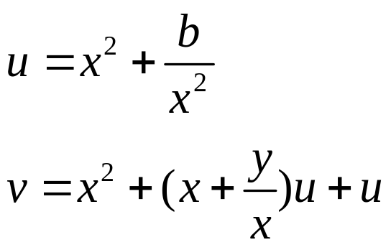
Computing the Half
Problem: Let E be the Elliptic Curve, defined by the equation:
Let Q=(u,v)=2P
Compute P=(x,y)
Remember :

Slide 77
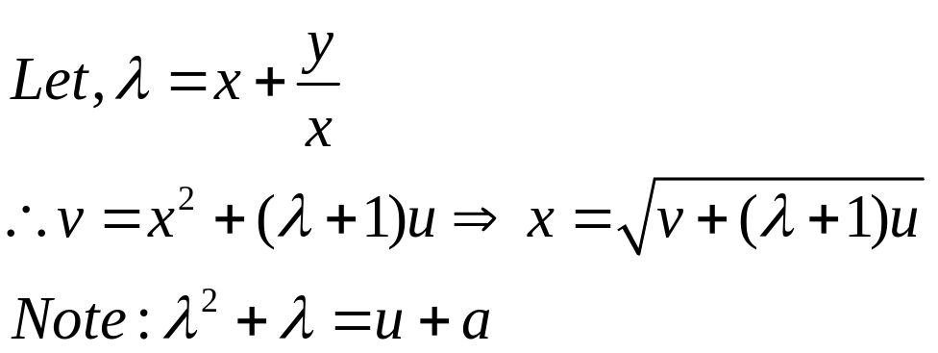
Halving (contd.)
Square
Root
Solving
Quadratics
Thus, we have to solve the above equations
λ-representation: (x, λ_{x})

Slide 78
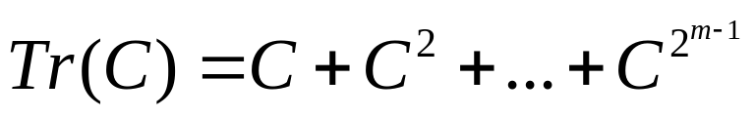
Trace of a point
Define:
Properties of Trace:
  Tr(c)=Tr(c²)=Tr(c)², Tr(c) can be 0 or 1
  Tr(c+d)=Tr(c)+Tr(d)
  NIST Curves : Tr(a)=1
  If x,y belongs to the Elliptic Curve, Tr(x)=Tr(a)

Slide 79

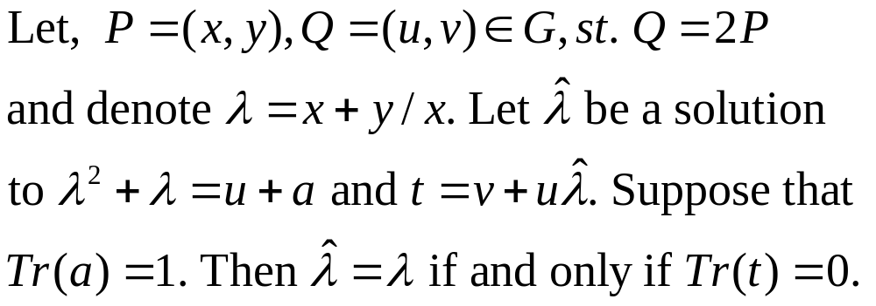
Computing λ
The roots of are λ₁= λ or λ+1
Theorem:

Slide 80


Halving Algorithm
Input: (u,v) , Output: (x,y)
Solve for λ. Let the root be
Compute
If Tr(t)=0, then λ_{P}= , x=(t+u)^{1/2}
else λ_{P}= +1,x=(t)^{1/2}
4. Return (x,λ_{P})

Slide 81
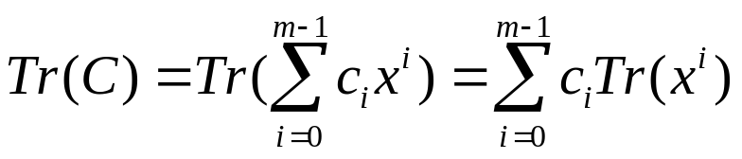
Implementation of Trace
Trace :
Can be evaluated in O(1) time
Example: GF(2¹⁶³), with reduction polynomial p(x)=x¹⁶³+x⁷+x⁶+x³+1, Tr(x^{i})=1, iff i=0 or 159.
Thus, the implementation is only one xor gate to add the 0th and the 159th bits of the register storing C.

Slide 82
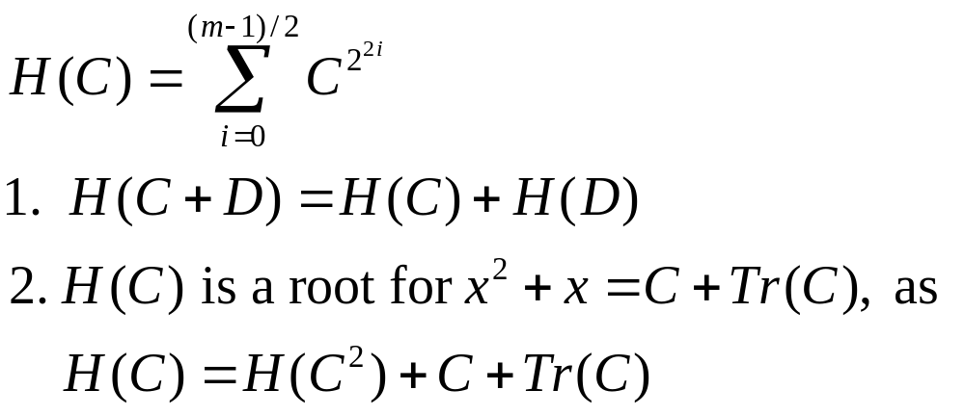
Solving a Quadratic over GF(2^{m})
Solve x²+x=c+Tr(c), c is an element of GF(2^{m})
Define Half Trace:
H(C) gives a root for the quadratic equation. A simple method to find
H(C) requires storage for m elements and m/2 field additions on an average

Slide 83
Obtaining Square Root
Field squaring in binary field is linear
Hence squaring can be rephrased as:
  C=MA=A²
We require to compute D st. D²=A
Let, D=M⁻¹A=> A=MD
D²=MD (as M is the squaring matrix)
=M(M⁻¹A)=A
Hence, D=(A)^{1/2}

Slide 84
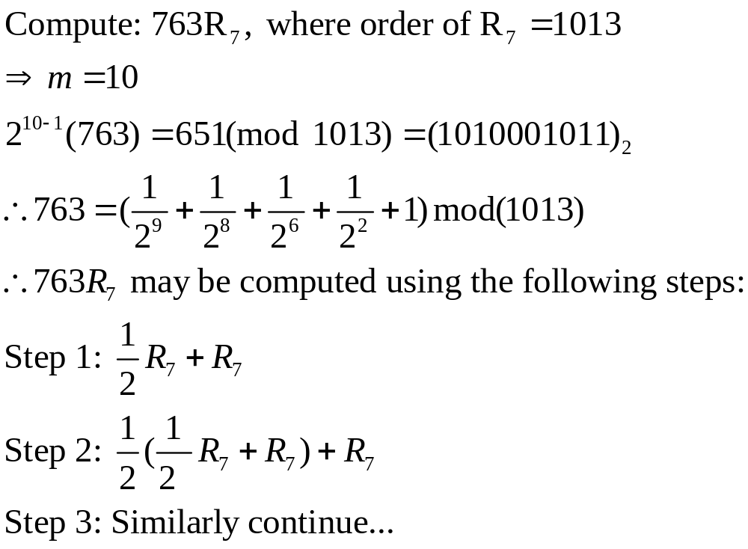
An Example

Slide 85

Half and Add Algorithm
Input: 0<k<n, P=(x,y)
Output: Q=kP
Compute: , k₁=(2^{t-1}k)mod n
Q=O
for i=0 to m-1 do
  Q=[1/2]Q
  If, k₁^{i}=1, then Q=Q+P
return Q
No method is currently known to perform point halving in projective
Coordinates. Keep Q in affine coordinates and P in Projective
Coordinates. Then step 5.2 is a mixed operation, giving further
efficiency.

Slide 86
Key References
Papers:
  J. Lopez and R. Dahab, “Fast Multiplication on Elliptic Curves over GF(2^{m}) without pre-computation”, CHES 1999
  K. Fong etal, “Field Inversion and Point Halving Revisited”, IEEE Trans on Comp, 2004
  G. Orlando and C. Paar, “A High Performance Reconfigurable Elliptic Curve Processor for GF(2^{m})”, CHES 2000
  N. A. Saqib etal, “A Parallel Architecture for Fast Computation of Elliptic Curve Scalar Multiplication over GF(2^{m})”, Elsevier Journal of Microprocessors and Microsystems, 2004
  Sabiel Mercurio etal, “ An FPGA Arithmetic Logic Unit for Computing Scalar Multiplication using the Half-and-Add Method”, IEEE ReConfig 2005

Slide 87
Key References
Books:
  Elliptic Curves: Number Theory and Cryptography, by Lawrence C. Washington
  Guide to Elliptic Curve Cryptography, Alfred J. Menezes
  Guide to Elliptic Curve Cryptography, Darrel R. Hankerson, A. Menezes and A. Vanstone
  http://cr.yp.to/ecdh.html ( Daniel Bernstein)

Slide 88
Thank You

